Slide 1
Professional Ethics
Meaning, Nature, Scope of Professional Ethics

Slide 2

What is Ethics ?

Slide 3
Why We Study Ethics?

Slide 4



Professional Ethics
Meaning
Nature
Scope

Slide 5
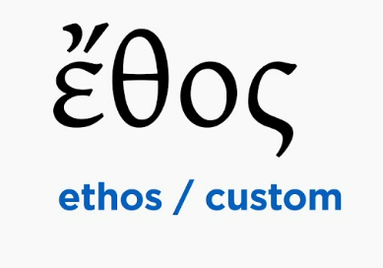
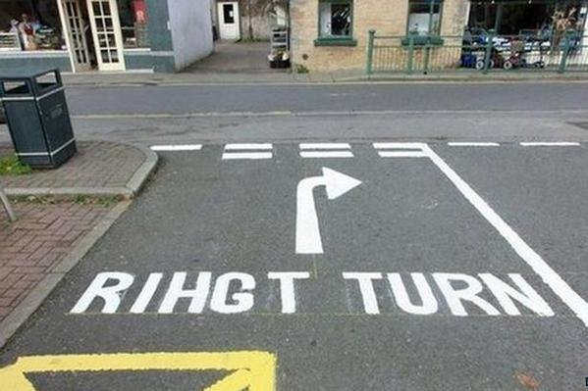

Meaning Of Professional Ethics
the word ethics is derived from a Greek word “ethos” which means character and conduct.
Ethics is a significant branch of philosophy which will give a set of guidelines to guide life
These guidelines will guide the individual to understand the fundamental difference between “what is right? & what is wrong?

Slide 6
Nature Of Professional Ethics

Slide 7
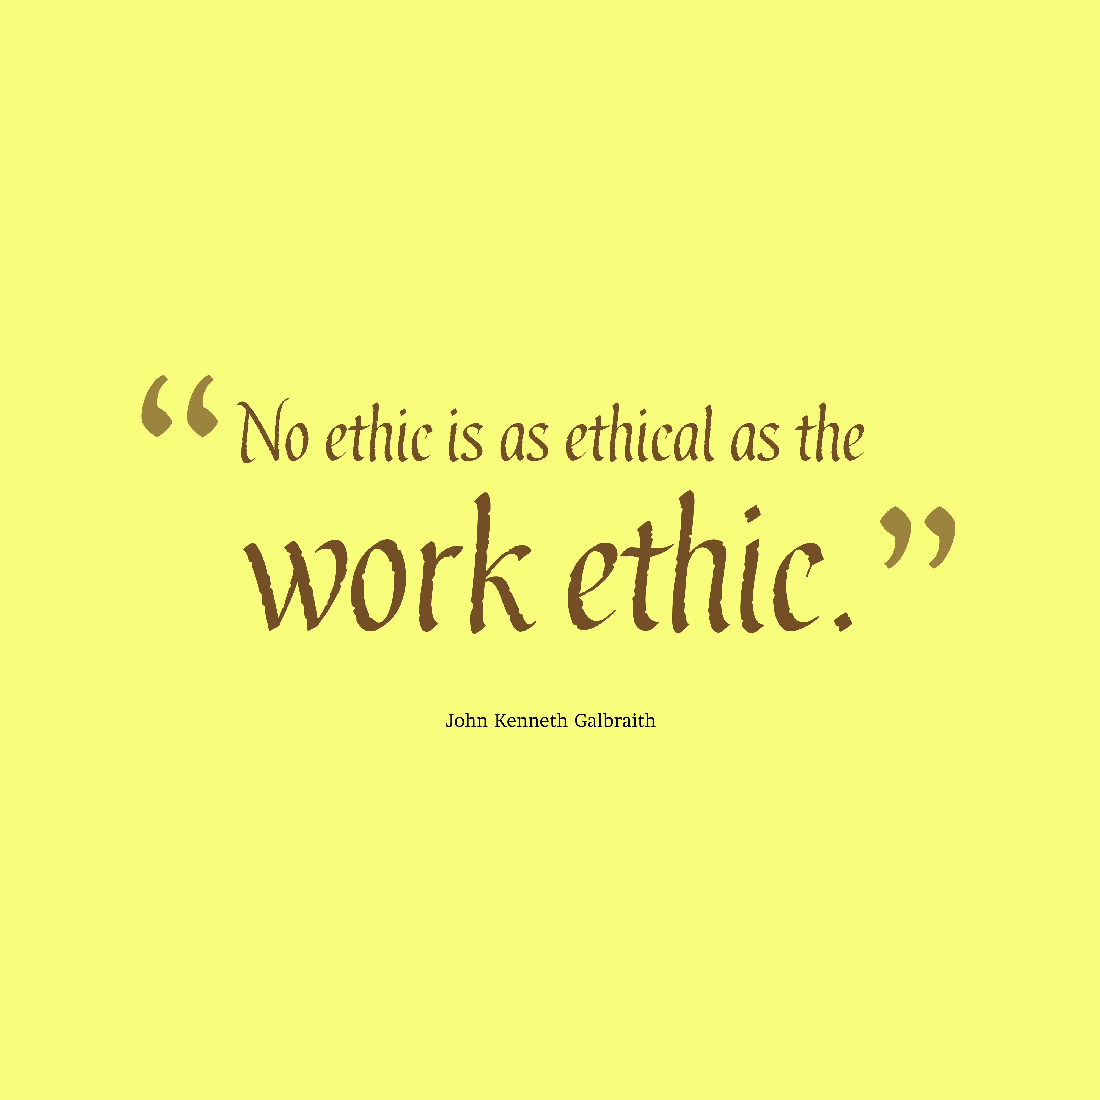
Nature Of Professional Ethics
Ethics is also a rational inquiry, which means that it relies on reason and logic to determine the best course of action in a given situation.
Ethics is different from natural and factual science because it is a normative science every science is concerned with a particular department of knowladge.

Slide 9

Include an iconic picture from the era.

Slide 10


Slide 11

Notes:
Create an outline to get ready:
Introduce the era (Use a mix of media and text)
Organize your artifacts to outline what life was like during the era you are presenting
Think about using a storyboard to outline your images and ideas
Make sure you prepare a clear and well rounded presentation of all aspects of the era (People, jobs, food, transportation, etc. What else should you include so the audience feels like they have visited your era?)

Slide 12
s
Scope Of Professional Ethics

Slide 13
s

Slide 14
s

Slide 15
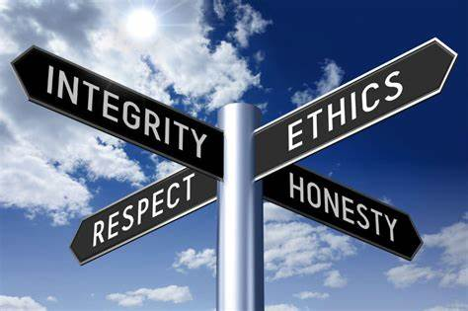
s

Slide 16
Conclusions
Meaning
Nature
Scope

